Slide 1
Question Paper Generator
Welcome! Today, we'll explore how question paper generation is revolutionizing the way exams are created.
Mohammed Arham Jamal (160922750097)
Mohammed Hameed Uddin (160922750105)
Mohammed Zaid Uddin (160922750117)
Abdul Haseeb(160922750061)

Slide 2

Benefits of Automated Question Paper Generation
1
Saves Time
2
Reduces Errors
Educators can spend less time manually creating exam papers.
Eliminates human errors in question selection and formatting.
3
Ensures Consistency
Generates standardized and professional-looking exams.

Slide 3
Applications Across Education
Schools and Universities
Training Institutes
Online Learning Platforms
Streamlines exam creation for diverse subjects and levels.
Efficiently generates assessments for various professional courses.
Enhances adaptive learning by creating personalized assessments.

Slide 4




Future Directions for Automated Question Paper Generation
AI Integration
AI can suggest relevant questions based on learning objectives and student performance.
Multimedia Questions
Support for multimedia content, such as images, audio, and video, to create engaging assessments.
LMS Integration
Seamlessly integrate with Learning Management Systems for efficient exam administration and data analysis.

Slide 5
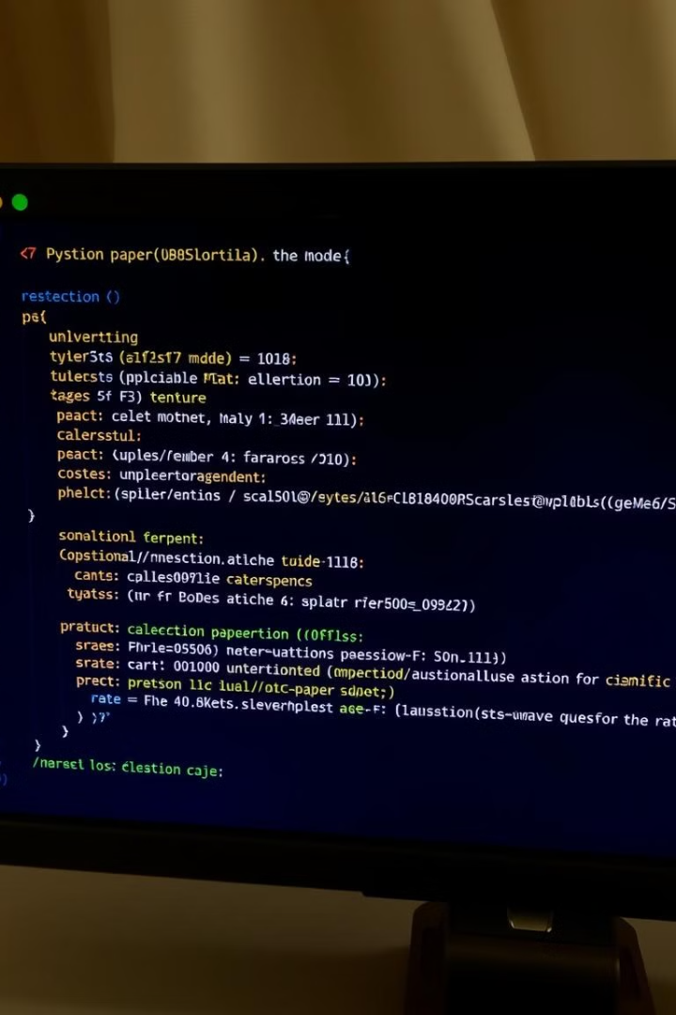
Key Libraries and Technologies
libariaries include: random, docx, sys ,tkinter random , os , json , datetime

Slide 6

Conclusion: The Future of Automated Examination Tools
Efficiency
Customization
Accessibility
Automated question paper generation is transforming the way we create and administer exams, offering a path towards a more efficient, customized, and accessible learning experience for all.

Slide 7


Question Paper Generator: Automating Examination Creation
Welcome! This presentation explores the exciting possibilities of automating examination question paper generation.
by AJ AJ

Slide 8
Unlocking Efficiency and Accuracy
Time-Saving
Enhanced Reliability
Reduce the time educators spend on manual question paper creation, allowing them to focus on more impactful tasks.
Eliminate the risk of human errors in question selection and paper assembly, ensuring consistent and accurate output.

Slide 9

Expanding Applications
Educational Institutions
Training Organizations
Streamline examination processes in schools and universities, facilitating efficient and standardized assessments.
Enhance training programs by automating the creation of quizzes and assessments for professional development.
E-Learning Platforms
Integrate with online learning platforms to provide dynamic and adaptable question generation for online courses.

Slide 10



Unleashing the Power of AI
AI-Driven Suggestions
Multimedia Integration
LMS Integration
Utilize AI to suggest relevant and appropriate questions based on learning objectives and course content.
Expand beyond traditional text-based questions to incorporate multimedia elements like images, audio, and video.
Seamlessly integrate with Learning Management Systems (LMS) to facilitate automated question paper generation and delivery.

Slide 11




Transforming Examination Practices
Streamlined Processes
Optimize examination procedures, ensuring efficiency and reducing manual workload.
Time Savings
Free up valuable time for educators to focus on instruction, student engagement, and personalized learning.
Enhanced Quality
Improve the quality and consistency of examination papers, ensuring fairness and reliability.

Slide 12

A Vision for the Future of Assessment
This project represents a significant step towards automating examination processes, paving the way for a future where assessment is efficient, accurate, and personalized.

